Slide 1
BBM-382 – SOFTWARE ENGINEERING
SPRING 2018
Lecture 2
Asst.Prof.Dr. Ayça TARHAN

Slide 2
CHAPTER 22 – PROJECT MANAGEMENT

Slide 3
Contents
22.1 Risk management (covered)
22.2 Managing people
22.3 Teamwork

Slide 4
What is a Project?
“A project is a temporary endeavour undertaken to create a unique product or service”
[Project Management Body of Knowledge-PMBOK, 2013]
“Temporary”
Has a start and an end date
“Unique”
Has specific attributes for its customers

Slide 5
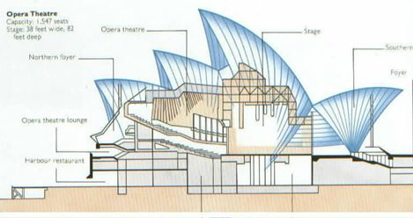

Example: Civil Engineering

Slide 6
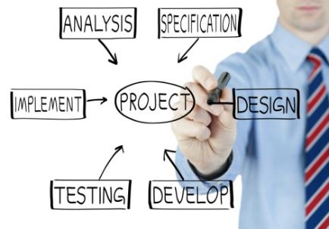
Example: Software Projects
Developing MS Vista (a new operating system)
Generic (commercial-off-the-shelf - COTS) software
Developing Airline Ticket Reservation System
Custom software

Slide 7
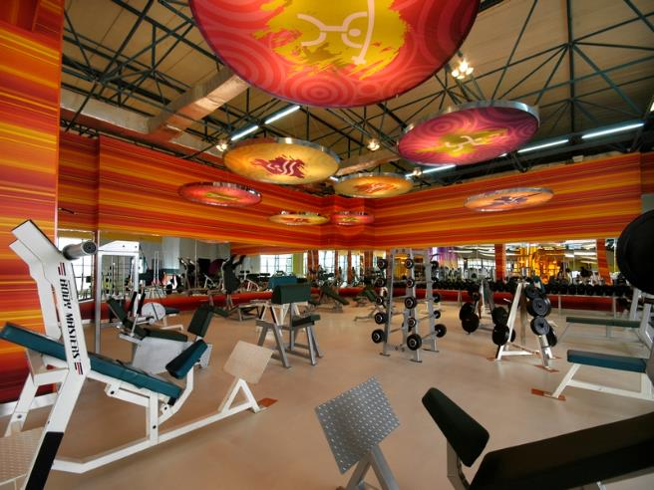
Product of the Sw.Eng.Lab. Project
System to be developed: Sports Center Membership System (SCMS)

Slide 8
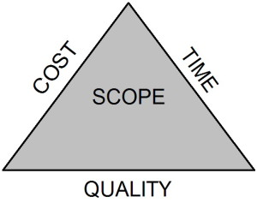
What is Project Management?
“Project management is the application of knowledge, skills, tools, and techniques to project activities in order to meet project requirements” [PMBOK, 2013]
Requires alignment among:
The parameters of time, cost, quality, etc.
The needs of different stakeholders

Slide 9
Project Management Process
[PMBOK, 2013]
“Project Management is accomplished through the appropriate application of five process groups which are:
Initiating, Planning, Executing, Monitoring and Controlling, and Closing.”
“Managing a project typically includes:
Identifying requirements,
Addressing the various needs, concerns, and expectations of the stakeholders as the project is planned and carried out,
Balancing the competing project constraints including (but not limited to):
Scope, Quality, Schedule, Budget, Resources, and Risk.”

Slide 10
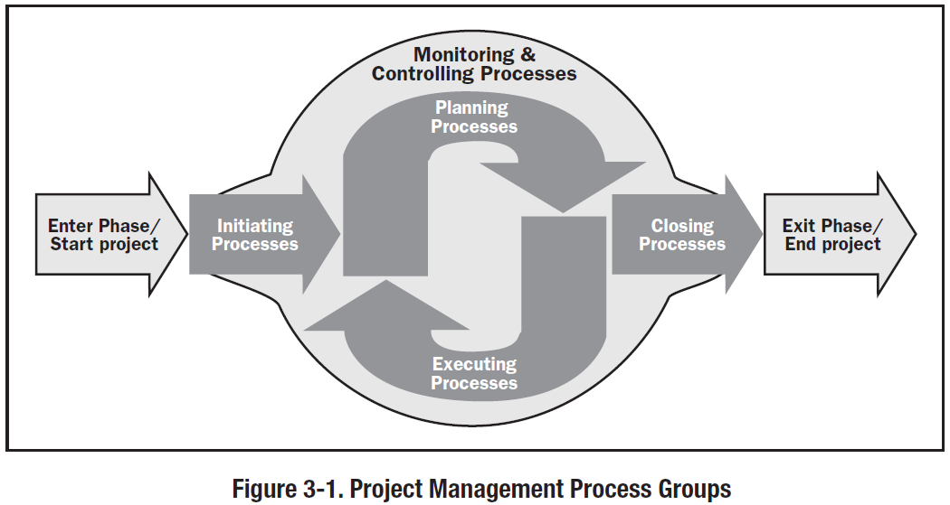
Project Management Process Groups [PMBOK, 2013]

Slide 11
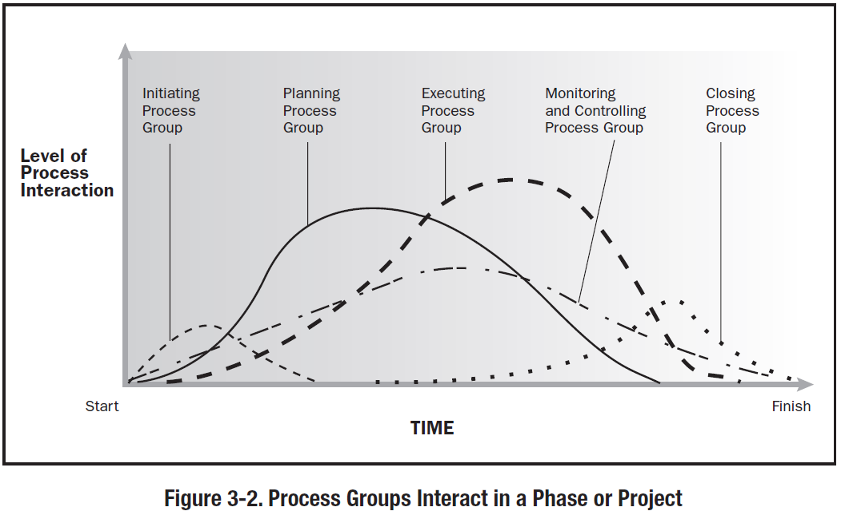
Project Management Processes with respect to time [PMBOK, 2013]

Slide 12
Software Project Management
Concerned with activities involved in ensuring that software is delivered on time and on schedule and in accordance with the requirements of the organisations developing and procuring the software.
Project management is needed because software development is always subject to budget and schedule constraints that are set by the organisation developing the software.

Slide 13

Success criteria
Deliver the software to the customer at the agreed time.
Keep overall costs within budget.
Deliver software that meets the customer’s expectations.
Maintain a happy and well-functioning development team.

Slide 14
Software management distinctions
The product is intangible.
Software cannot be seen or touched. Software project managers cannot see progress by simply looking at the artefact that is being constructed.
Many software projects are 'one-off' projects.
Large software projects are usually different in some ways from previous projects. Even managers who have lots of previous experience may find it difficult to anticipate problems.
Software processes are variable & organization specific.
We still cannot reliably predict when a particular software process is likely to lead to development problems.

Slide 15
We need management activities!
Project planning
Project managers are responsible for planning. estimating and scheduling project development and assigning people to tasks.
Reporting
Project managers are usually responsible for reporting on the progress of a project to customers and to the managers of the company developing the software.
Risk management
Project managers assess the risks that may affect a project, monitor these risks and take action when problems arise.
People management
Project managers have to choose people for their team and establish ways of working that leads to effective team performance
Proposal writing
The first stage in a software project may involve writing a proposal to win a contract to carry out an item of work. The proposal describes the objectives of the project and how it will be carried out.

Slide 16

People management - Teamwork
Most software engineering is a group activity.
The development schedule for most non-trivial software projects is such that they cannot be completed by one person working alone.
A good group is cohesive and has a team spirit.
The people involved are motivated by the success of the group as well as by their own personal goals.
Group interaction is a key determinant of group performance.
Flexibility in group composition is limited.
Managers must do the best they can
with available people.

Slide 17

People management - Group cohesiveness
In a cohesive group, members consider the group to be more important than any individual in it.
The advantages of a cohesive group are:
Group quality standards can be developed by the group members.
Team members learn from each other and get to know each other’s work; Inhibitions caused by ignorance are reduced.
Knowledge is shared. Continuity can be maintained if a group member leaves.
Refactoring and continual improvement is encouraged. Group members work collectively to deliver high quality results and fix problems, irrespective of the individuals who originally created the design or program.

Slide 18
Risk management
Risk management is concerned with identifying risks and drawing up plans to minimise their effect on a project.
A risk is a probability that some adverse circumstance will occur
Project risks affect schedule or resources;
Product risks affect the quality or performance of the software being developed;
Business risks affect the organisation developing or procuring the software.

Slide 19
Examples of common project, product, and business risks
Risk | Affects | Description
Staff turnover | Project | Experienced staff will leave the project before it is finished.
Management change | Project | There will be a change of organizational management with different priorities.
Hardware unavailability | Project | Hardware that is essential for the project will not be delivered on schedule.
Requirements change | Project and product | There will be a larger number of changes to the requirements than anticipated.
Specification delays | Project and product | Specifications of essential interfaces are not available on schedule.
Size underestimate | Project and product | The size of the system has been underestimated.
CASE tool underperformance | Product | CASE tools, which support the project, do not perform as anticipated.
Technology change | Business | The underlying technology on which the system is built is superseded by new technology.
Product competition | Business | A competitive product is marketed before the system is completed.

Slide 20
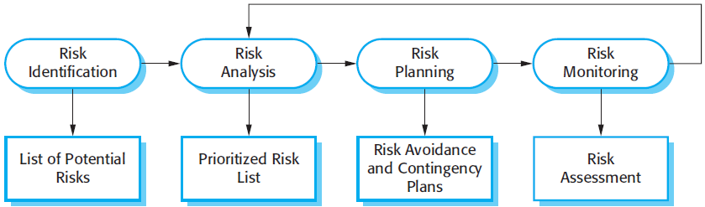
The risk management process
Risk identification - Identify project, product and business risks;
Risk analysis - Assess the likelihood and consequences of these risks;
Risk planning - Draw up plans to avoid or minimise effects of the risk;
Risk monitoring - Monitor the risks throughout the project.

Slide 21
Risk identification
May be a team activities or based on the individual project manager’s experience.
A checklist of common risks may be used to identify risks in a project
Technology risks
People risks
Organisational risks
Requirements risks
Estimation risks

Slide 22
Risk indicators
Risk type | Potential indicators
Technology | Late delivery of hardware or support software; many reported technology problems.
People | Poor staff morale; poor relationships amongst team members; high staff turnover.
Organizational | Organizational gossip; lack of action by senior management.
Tools | Reluctance by team members to use tools; complaints about CASE tools; demands for higher-powered workstations.
Requirements | Many requirements change requests; customer complaints.
Estimation | Failure to meet agreed schedule; failure to clear reported defects.

Slide 23
Examples of different risk types
Risk type | Possible risks
Technology | The database used in the system cannot process as many transactions per second as expected. (1) Reusable software components contain defects that mean they cannot be reused as planned. (2)
People | It is impossible to recruit staff with the skills required. (3) Key staff are ill and unavailable at critical times. (4) Required training for staff is not available. (5)
Organizational | The organization is restructured so that different management are responsible for the project. (6) Organizational financial problems force reductions in the project budget. (7)
Tools | The code generated by software code generation tools is inefficient. (8) Software tools cannot work together in an integrated way. (9)
Requirements | Changes to requirements that require major design rework are proposed. (10) Customers fail to understand the impact of requirements changes. (11)
Estimation | The time required to develop the software is underestimated. (12) The rate of defect repair is underestimated. (13) The size of the software is underestimated. (14)

Slide 24
Risk analysis
Assess probability and consequences of each risk.
Probability may be:
very low, low, moderate, high or very high.
Risk consequences might be:
catastrophic, serious, tolerable or insignificant.

Slide 25
Risk types and examples
HIGH IMPACT !!!
Risk | Probability | Effects
Organizational financial problems force reductions in the project budget (7). | Low | Catastrophic
It is impossible to recruit staff with the skills required for the project (3). | High | Catastrophic
Key staff are ill at critical times in the project (4). | Moderate | Serious
Faults in reusable software components have to be repaired before these components are reused. (2). | Moderate | Serious
Changes to requirements that require major design rework are proposed (10). | Moderate | Serious
The organization is restructured so that different management are responsible for the project (6). | High | Serious
The database used in the system cannot process as many transactions per second as expected (1). | Moderate | Serious
The time required to develop the software is underestimated (12). | High | Serious
Software tools cannot be integrated (9). | High | Tolerable
Customers fail to understand the impact of requirements changes (11). | Moderate | Tolerable
Required training for staff is not available (5). | Moderate | Tolerable
The rate of defect repair is underestimated (13). | Moderate | Tolerable
The size of the software is underestimated (14). | High | Tolerable
Code generated by code generation tools is inefficient (8). | Moderate | Insignificant

Slide 26
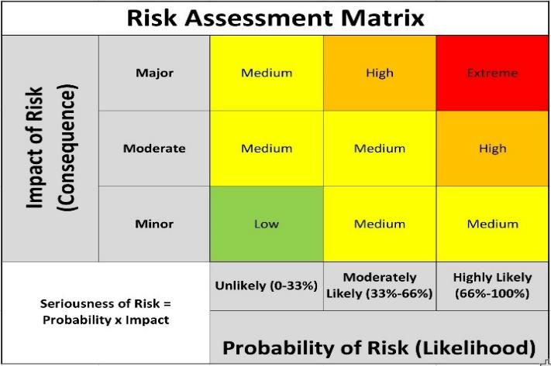
Risk Analysis: An Example

Slide 27
Risk planning
Consider each risk and develop a strategy to manage that risk.
Avoidance strategies
The probability that the risk will arise is reduced.
Minimisation strategies
The impact of the risk on the project or product will be reduced.
Contingency plans
If the risk arises, contingency plans are plans to deal with that risk.

Slide 28
Strategies to help manage risk
Risk | Strategy
Organizational financial problems | Prepare a briefing document for senior management showing how the project is making a very important contribution to the goals of the business and presenting reasons why cuts to the project budget would not be cost-effective.
Recruitment problems | Alert customer to potential difficulties and the possibility of delays; investigate buying-in components.
Staff illness | Reorganize team so that there is more overlap of work and people therefore understand each other’s jobs.
Defective components | Replace potentially defective components with bought-in components of known reliability.
Requirements changes | Derive traceability information to assess requirements change impact; maximize information hiding in the design.
Organizational restructuring | Prepare a briefing document for senior management showing how the project is making a very important contribution to the goals of the business.
Database performance | Investigate the possibility of buying a higher-performance database.
Underestimated development time | Investigate buying-in components; investigate use of a program generator.

Slide 29
Risk monitoring
Assess each identified risks regularly to decide whether or not it is becoming less or more probable.
Also assess whether the effects of the risk have changed.
Each key risk should be discussed at management progress meetings.

Slide 30
Key Points
Good project management is essential if software engineering projects are to be developed on schedule and within budget.
Software management is distinct from other engineering management. Software is intangible. Projects may be novel or innovative with no body of experience to guide their management. Software processes are not as mature as traditional engineering processes.
Risk management is now recognized as one of the most important project management tasks.
Risk management involves identifying and assessing project risks to establish the probability that they will occur and the consequences for the project if that risk does arise. You should make plans to avoid, manage or deal with likely risks if or when they arise.

Slide 31
CHAPTER 22 – PROJECT PLANNING

Slide 32
Contents
Software pricing (covered)
Plan-driven development (covered)
Project scheduling (covered)
Agile planning
Estimation techniques

Slide 33
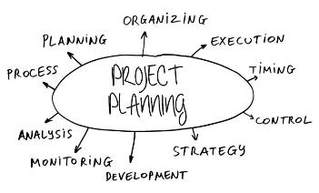
Project planning
Project planning involves:
breaking down the work into parts,
assigning these parts to project team members,
anticipating problems that might arise, and
preparing tentative solutions to those problems.
The project plan, which is created at the start of a project, is used:
to communicate how the work will be done to the project team and customers, and
to help assess progress on the project.

Slide 34
Planning stages
At the proposal stage,
→ when you are bidding for a contract to develop or provide a software system.
During the project startup phase,
→ when you have to plan who will work on the project, how the project will be broken down into increments, how resources will be allocated across company, etc.
Periodically throughout the project,
→ when you modify your plan in the light of experience gained and information from monitoring the progress of the work.

Slide 35
Proposal planning
Planning may be necessary with only outline software requirements.
The aim of planning at this stage is to provide information that will be used in setting a price for the system to customers.

Slide 36
Software pricing
Estimates are made to discover the cost of producing a software system.
You take into account: hardware, software, travel, training and effort costs.
There is not a simple relationship between the development cost and the price charged to the customer.
Broader organisational, economic, political and business considerations influence the price charged.

Slide 37


Plan-driven development
Plan-driven or plan-based development is an approach to software engineering where the development process is planned in detail.
Plan-driven development is based on engineering project management techniques and is the ‘traditional’ way of managing large software development projects.
A project plan is created that records the work to be done, who will do it, the development schedule and the work products.
Managers use the plan to support project decision making and as a way of measuring progress.

Slide 38
Plan-driven development – pros and cons
The arguments in favor of a plan-driven approach are that:
Early planning allows organizational issues (availability of staff, other projects, etc.) to be closely taken into account, and
Potential problems and dependencies are discovered before the project starts, rather than once the project is underway.
The principal argument against plan-driven development is that:
Many early decisions have to be revised because of changes to the environment in which the software is to be developed and used.

Slide 39
Project plans
In a plan-driven development project, a project plan sets out the resources available to the project, the work breakdown and a schedule for carrying out the work.
Plan sections:
Introduction
Project organization
Risk analysis
Hardware and software resource requirements
Work breakdown
Project schedule
Monitoring and reporting mechanisms

Slide 40
The planning process
Project planning is an iterative process that starts when you create an initial project plan during the project startup phase.
Plan changes are inevitable.
As more information about the system and the project team becomes available during the project, you should regularly revise the plan to reflect requirements, schedule and risk changes.
Changing business goals also leads to changes in project plans. As business goals change, this could affect all projects, which may then have to be re-planned.

Slide 41
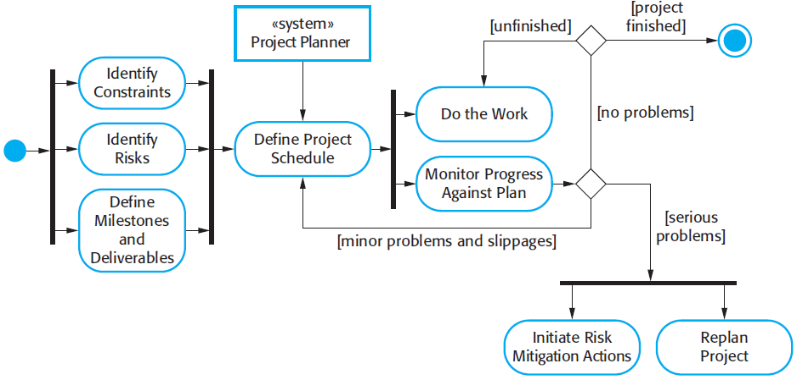
The project planning process

Slide 42
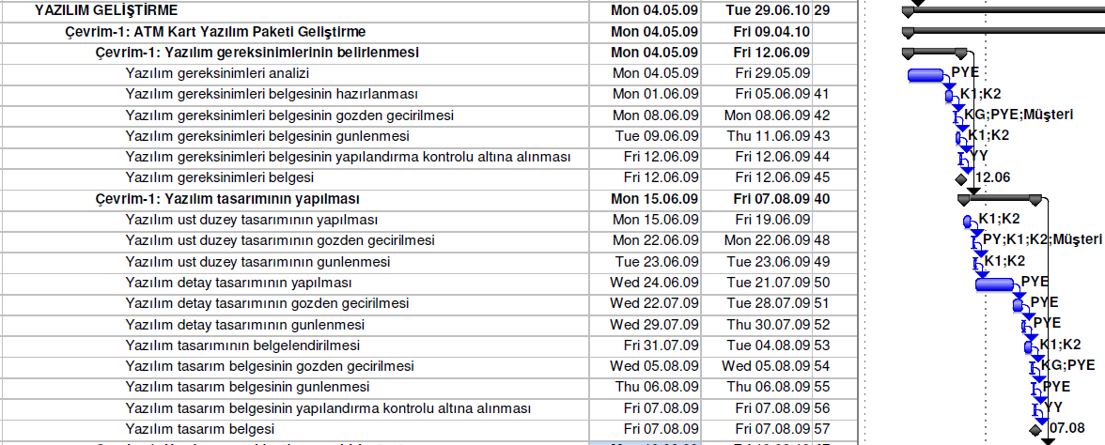
Milestones and deliverables
Milestones are points in the schedule against which you can assess progress, for example, the handover of the system for testing.
Deliverables are work products that are delivered to the customer, e.g. a requirements document for the system.

Slide 43
Project scheduling
Project scheduling is the process of deciding how the work in a project will be organized as separate tasks, and when and how these tasks will be executed.
You estimate the calendar time needed to complete each task, the effort required and who will work on the tasks that have been identified.
You also have to estimate the resources needed to complete each task, such as the disk space required on a server, the time required on specialized hardware, such as a simulator, and what the travel budget will be.

Slide 44
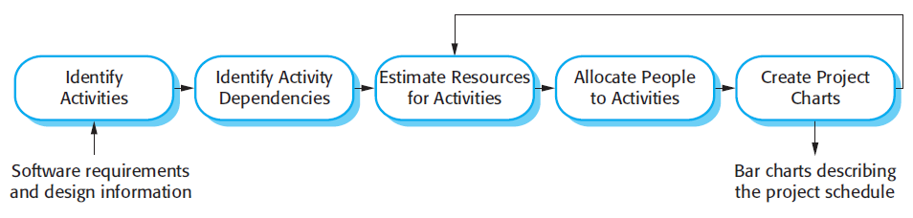
Project scheduling activities
Split project into tasks and estimate time and resources required to complete each task.
Organize tasks concurrently to make optimal use of workforce.
Minimize task dependencies to avoid delays caused by one task waiting for another to complete.
Dependent on project managers intuition and experience.

Slide 45
Scheduling problems
Estimating the difficulty of problems and hence the cost of developing a solution is hard.
Productivity is not proportional to the number of people working on a task.
Adding people to a late project makes it later because of communication overheads.
The unexpected always happens. Always allow contingency in planning.

Slide 46
Schedule representation
Graphical notations are normally used to illustrate the project schedule.
These show the project breakdown into tasks. Tasks should not be too small. They should take about a week or two.
Bar charts are the most commonly used representation for project schedules. They show the schedule as activities or resources against time.

Slide 47
Tasks, durations, and dependencies
Task | Effort (person-days) | Duration (days) | Dependencies
T1 | 15 | 10
T2 | 8 | 15
T3 | 20 | 15 | T1 (M1)
T4 | 5 | 10
T5 | 5 | 10 | T2, T4 (M3)
T6 | 10 | 5 | T1, T2 (M4)
T7 | 25 | 20 | T1 (M1)
T8 | 75 | 25 | T4 (M2)
T9 | 10 | 15 | T3, T6 (M5)
T10 | 20 | 15 | T7, T8 (M6)
T11 | 10 | 10 | T9 (M7)
T12 | 20 | 10 | T10, T11 (M8)

Slide 48
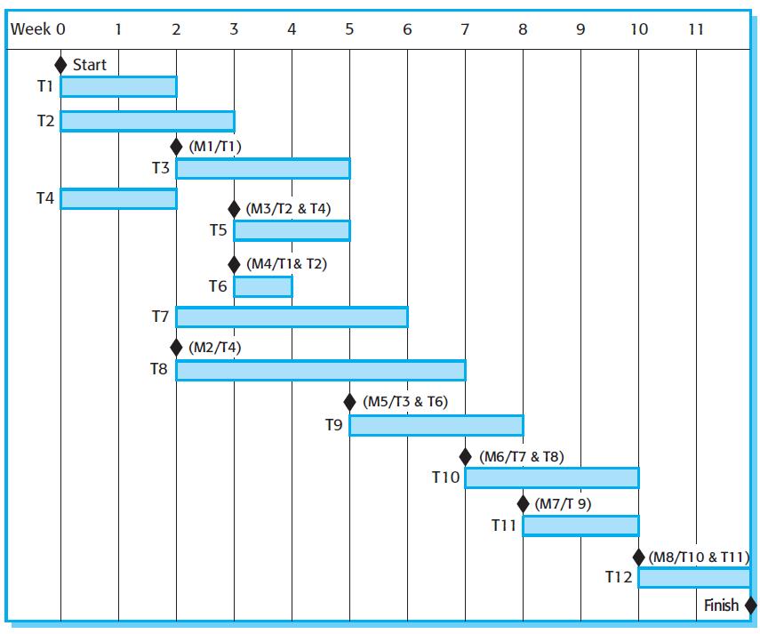
Activity bar chart

Slide 49
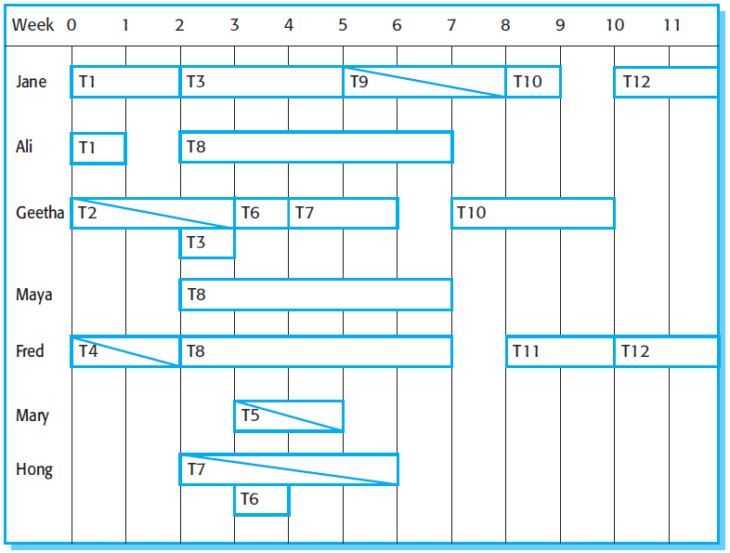
Staff allocation chart

Slide 50
Example: ATM System Software Development Project Plan
Full plan is available in the share area of course lecture notes.

Slide 51
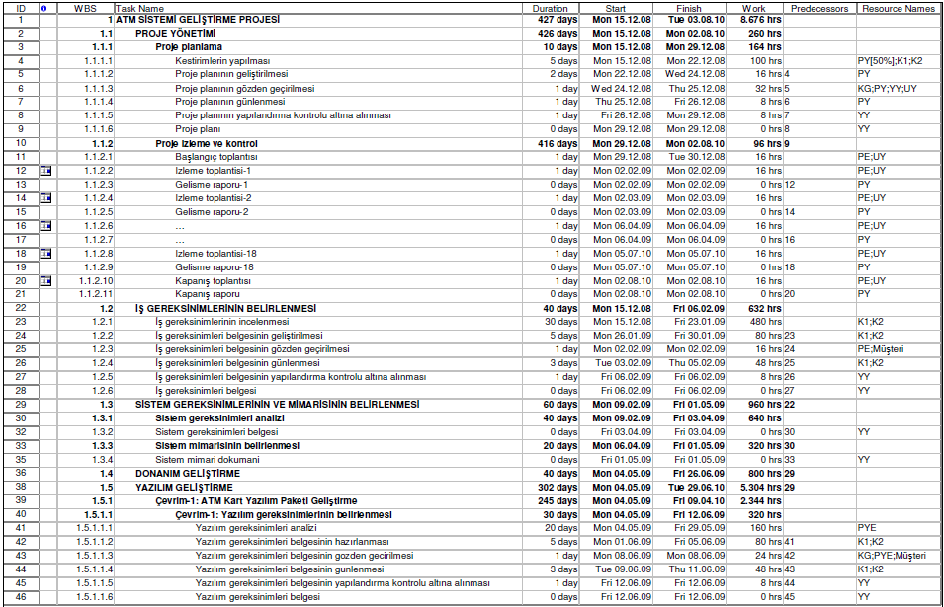
Example: ATM System Software Development (Tasks and dependencies, Schedule, Effort, Resources)

Slide 52
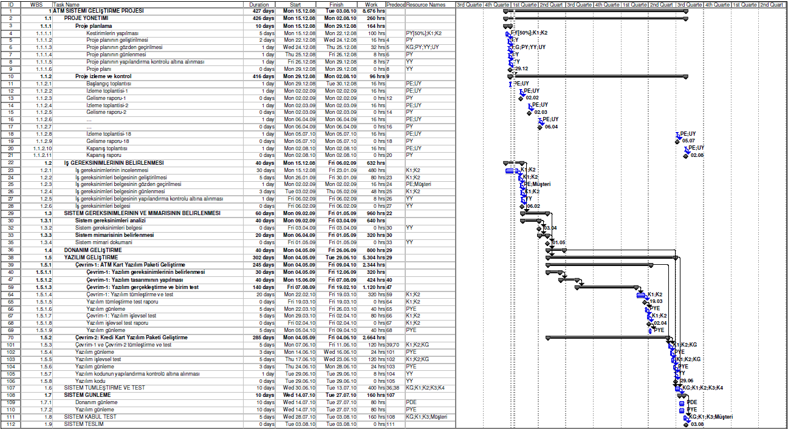
Example: ATM System Software Development (Tasks and dependencies – Gantt Chart)

Slide 53
Key points
The price charged for a system does not just depend on its estimated development costs; it may be adjusted depending on the market and organizational priorities.
Plan-driven development is organized around a complete project plan that defines the project activities, the planned effort, the activity schedule and who is responsible for each activity.
Project scheduling involves the creation of graphical representations the project plan. Bar charts show the activity duration and staffing timelines, are the most commonly used schedule representations.

Slide 54
For student reading…

Slide 55
Project plan supplements
Plan | Description
Quality plan | Describes the quality procedures and standards that will be used in a project.
Validation plan | Describes the approach, resources, and schedule used for system validation.
Configuration management plan | Describes the configuration management procedures and structures to be used.
Maintenance plan | Predicts the maintenance requirements, costs, and effort.
Staff development plan | Describes how the skills and experience of the project team members will be developed.

Slide 56
Factors affecting software pricing
Factor | Description
Market opportunity | A development organization may quote a low price because it wishes to move into a new segment of the software market. Accepting a low profit on one project may give the organization the opportunity to make a greater profit later. The experience gained may also help it develop new products.
Cost estimate uncertainty | If an organization is unsure of its cost estimate, it may increase its price by a contingency over and above its normal profit.
Contractual terms | A customer may be willing to allow the developer to retain ownership of the source code and reuse it in other projects. The price charged may then be less than if the software source code is handed over to the customer.
Requirements volatility | If the requirements are likely to change, an organization may lower its price to win a contract. After the contract is awarded, high prices can be charged for changes to the requirements.
Financial health | Developers in financial difficulty may lower their price to gain a contract. It is better to make a smaller than normal profit or break even than to go out of business. Cash flow is more important than profit in difficult economic times.

Slide 57
Estimation techniques
Organizations need to make software effort and cost estimates. There are two types of technique that can be used to do this:
Experience-based techniques The estimate of future effort requirements is based on the manager’s experience of past projects and the application domain. Essentially, the manager makes an informed judgment of what the effort requirements are likely to be.
Algorithmic cost modeling In this approach, a formulaic approach is used to compute the project effort based on estimates of product attributes, such as size, and process characteristics, such as experience of staff involved.

Slide 58
Experience-based approaches
Experience-based techniques rely on judgments based on experience of past projects and the effort expended in these projects on software development activities.
Typically, you identify the deliverables to be produced in a project and the different software components or systems that are to be developed.
You document these in a spreadsheet, estimate them individually and compute the total effort required.
It usually helps to get a group of people involved in the effort estimation and to ask each member of the group to explain their estimate.

Slide 59
Algorithmic cost modelling
Cost is estimated as a mathematical function of product, project and process attributes whose values are estimated by project managers:
Effort = A × Size^{B} × M
A is an organisation-dependent constant, B reflects the disproportionate effort for large projects and M is a multiplier reflecting product, process and people attributes.
The most commonly used product attribute for cost estimation is code size.
Most models are similar but they use different values for A, B and M.

Slide 60
Estimation accuracy
The size of a software system can only be known accurately when it is finished.
Several factors influence the final size
Use of COTS and components;
Programming language;
Distribution of system.
As the development process progresses then the size estimate becomes more accurate.
The estimates of the factors contributing to B and M are subjective and vary according to the judgment of the estimator.

Slide 61
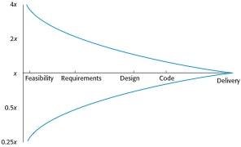
Estimate uncertainty

Slide 62
The COCOMO 2 model
An empirical model based on project experience.
Well-documented, ‘independent’ model which is not tied to a specific software vendor.
Long history from initial version published in 1981 (COCOMO-81) through various instantiations to COCOMO 2.
COCOMO 2 takes into account different approaches to software development, reuse, etc.

Slide 63
COCOMO 2 models
COCOMO 2 incorporates a range of sub-models that produce increasingly detailed software estimates.
The sub-models in COCOMO 2 are:
Application composition model. Used when software is composed from existing parts.
Early design model. Used when requirements are available but design has not yet started.
Reuse model. Used to compute the effort of integrating reusable components.
Post-architecture model. Used once the system architecture has been designed and more information about the system is available.

Slide 64
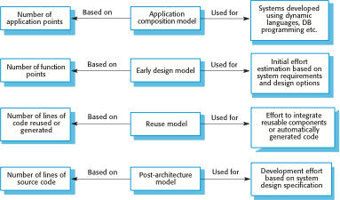
COCOMO estimation models

Slide 65
Application composition model
Supports prototyping projects and projects where there is extensive reuse.
Based on standard estimates of developer productivity in application (object) points/month.
Takes CASE tool use into account.
Formula is
PM = ( NAP × (1 - %reuse/100 ) ) / PROD
PM is the effort in person-months, NAP is the number of application points and PROD is the productivity.

Slide 66
Application-point productivity
Developer’s experience and capability | Very low | Low | Nominal | High | Very high
ICASE maturity and capability | Very low | Low | Nominal | High | Very high
PROD (NAP/month) | 4 | 7 | 13 | 25 | 50

Slide 67
Early design model
Estimates can be made after the requirements have been agreed.
Based on a standard formula for algorithmic models
PM = A × Size^{B} × M where
M = PERS × RCPX × RUSE × PDIF × PREX × FCIL × SCED;
A = 2.94 in initial calibration, Size in KLOC, B varies from 1.1 to 1.24 depending on novelty of the project, development flexibility, risk management approaches and the process maturity.

Slide 68
Multipliers
Multipliers reflect the capability of the developers, the non-functional requirements, the familiarity with the development platform, etc.
RCPX - product reliability and complexity;
RUSE - the reuse required;
PDIF - platform difficulty;
PREX - personnel experience;
PERS - personnel capability;
SCED - required schedule;
FCIL - the team support facilities.

Slide 69
The reuse model
Takes into account black-box code that is reused without change and code that has to be adapted to integrate it with new code.
There are two versions:
Black-box reuse where code is not modified. An effort estimate (PM) is computed.
White-box reuse where code is modified. A size estimate equivalent to the number of lines of new source code is computed. This then adjusts the size estimate for new code.

Slide 70
Reuse model estimates 1
For generated code:
PM = (ASLOC * AT/100)/ATPROD
ASLOC is the number of lines of generated code
AT is the percentage of code automatically generated.
ATPROD is the productivity of engineers in integrating this code.

Slide 71
Reuse model estimates 2
When code has to be understood and integrated:
ESLOC = ASLOC * (1-AT/100) * AAM.
ASLOC and AT as before.
AAM is the adaptation adjustment multiplier computed from the costs of changing the reused code, the costs of understanding how to integrate the code and the costs of reuse decision making.

Slide 72
Post-architecture level
Uses the same formula as the early design model but with 17 rather than 7 associated multipliers.
The code size is estimated as:
Number of lines of new code to be developed;
Estimate of equivalent number of lines of new code computed using the reuse model;
An estimate of the number of lines of code that have to be modified according to requirements changes.

Slide 73
The exponent term
This depends on 5 scale factors (see next slide). Their sum/100 is added to 1.01
A company takes on a project in a new domain. The client has not defined the process to be used and has not allowed time for risk analysis. The company has a CMM level 2 rating.
Precedenteness - new project (4)
Development flexibility - no client involvement - Very high (1)
Architecture/risk resolution - No risk analysis - V. Low .(5)
Team cohesion - new team - nominal (3)
Process maturity - some control - nominal (3)
Scale factor is therefore 1.17.

Slide 74
Scale factors used in the exponent computation in the post-architecture model
Scale factor | Explanation
Precedentedness | Reflects the previous experience of the organization with this type of project. Very low means no previous experience; extra-high means that the organization is completely familiar with this application domain.
Development flexibility | Reflects the degree of flexibility in the development process. Very low means a prescribed process is used; extra-high means that the client sets only general goals.
Architecture/risk resolution | Reflects the extent of risk analysis carried out. Very low means little analysis; extra-high means a complete and thorough risk analysis.
Team cohesion | Reflects how well the development team knows each other and work together. Very low means very difficult interactions; extra-high means an integrated and effective team with no communication problems.
Process maturity | Reflects the process maturity of the organization. The computation of this value depends on the CMM Maturity Questionnaire, but an estimate can be achieved by subtracting the CMM process maturity level from 5.

Slide 75
Multipliers
Product attributes
Concerned with required characteristics of the software product being developed.
Computer attributes
Constraints imposed on the software by the hardware platform.
Personnel attributes
Multipliers that take the experience and capabilities of the people working on the project into account.
Project attributes
Concerned with the particular characteristics of the software development project.

Slide 76
The effect of cost drivers on effort estimates
Exponent value | 1.17
System size (including factors for reuse and requirements volatility) | 128,000 DSI
Initial COCOMO estimate without cost drivers | 730 person-months
Reliability | Very high, multiplier = 1.39
Complexity | Very high, multiplier = 1.3
Memory constraint | High, multiplier = 1.21
Tool use | Low, multiplier = 1.12
Schedule | Accelerated, multiplier = 1.29
Adjusted COCOMO estimate | 2,306 person-months

Slide 77
The effect of cost drivers on effort estimates
Exponent value | 1.17
Reliability | Very low, multiplier = 0.75
Complexity | Very low, multiplier = 0.75
Memory constraint | None, multiplier = 1
Tool use | Very high, multiplier = 0.72
Schedule | Normal, multiplier = 1
Adjusted COCOMO estimate | 295 person-months

Slide 78
Project duration and staffing
As well as effort estimation, managers must estimate the calendar time required to complete a project and when staff will be required.
Calendar time can be estimated using a COCOMO 2 formula
TDEV = 3 × (PM)^{(0.33+0.2*(B-1.01))}
PM is the effort computation and B is the exponent computed as discussed above (B is 1 for the early prototyping model). This computation predicts the nominal schedule for the project.
The time required is independent of the number of people working on the project.

Slide 79
Staffing requirements
Staff required can’t be computed by diving the development time by the required schedule.
The number of people working on a project varies depending on the phase of the project.
The more people who work on the project, the more total effort is usually required.
A very rapid build-up of people often correlates with schedule slippage.

Slide 80
Key points
Estimation techniques for software may be experience-based, where managers judge the effort required, or algorithmic, where the effort required is computed from other estimated project parameters.
The COCOMO II costing model is an algorithmic cost model that uses project, product, hardware and personnel attributes as well as product size and complexity attributes to derive a cost estimate.

